Slide 1



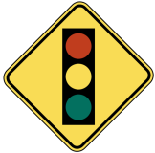


Montana Teen Driver Education and Training
Module 2.3.2
Traffic Control and Laws
Signs and Signals
Notes:
Revised 2018

Slide 2
Objectives
Understand need and purpose for traffic control signs, signals and road markings.
List and describe signs, signals and road markings.
Describe appropriate driver responses to signs, signals and road markings.
Apply traffic laws for operating a vehicle on public streets and highways.

Slide 3

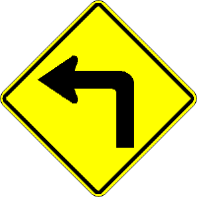
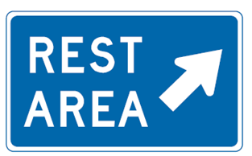
Traffic signs have three purposes:
Regulate
Traffic movement and parking
Warn
Potential dangers and road conditions
Guide
Provide information
Notes:
Regulate traffic, movement or parking
Warn of potential dangers or road conditions
Provide information and guidance

Slide 4
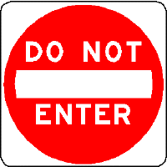
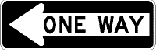
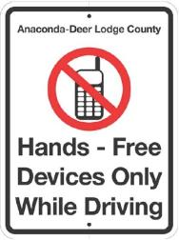
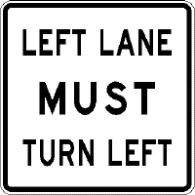
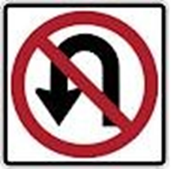
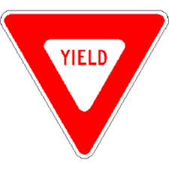

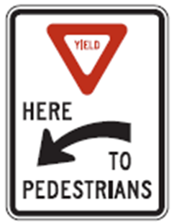
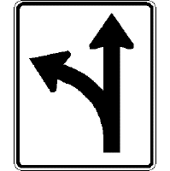
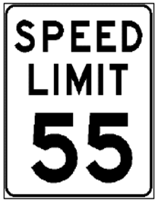
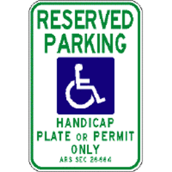
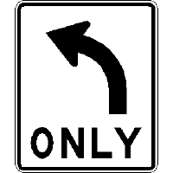
Regulatory Signs

Slide 5

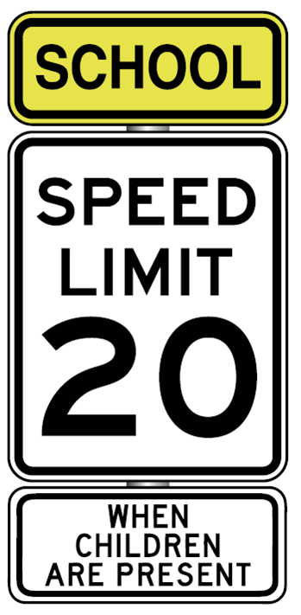
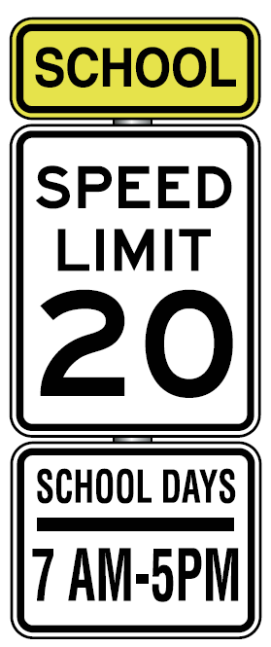

Slide 6

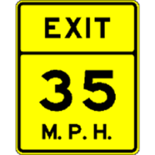
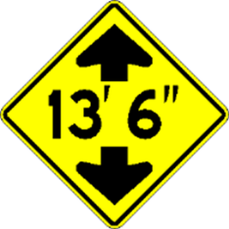
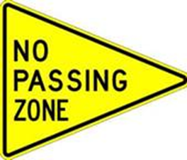
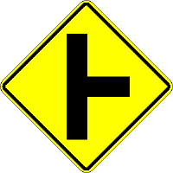
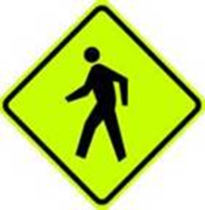
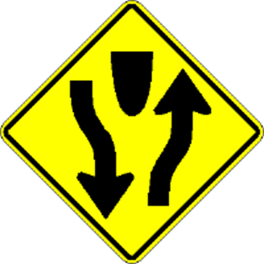

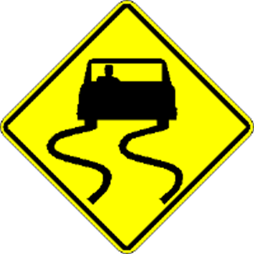
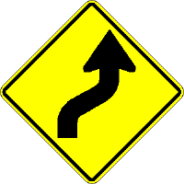
Warning Signs

Slide 7
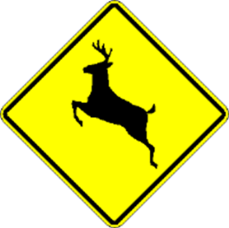
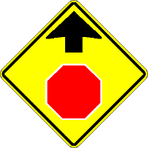
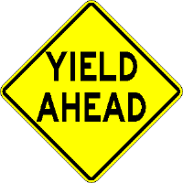
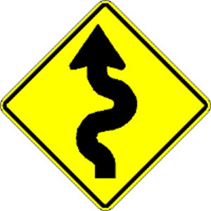
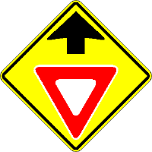


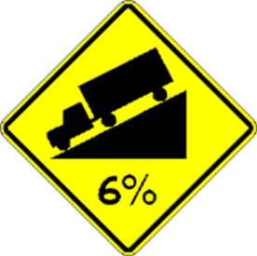
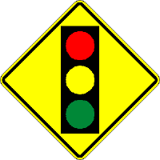
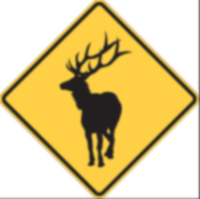
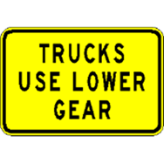
Warning Signs

Slide 8
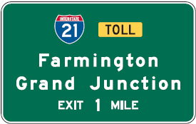
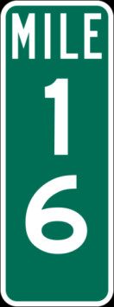

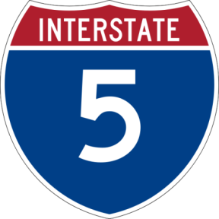
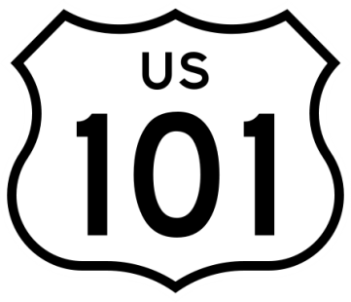
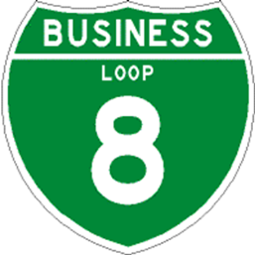
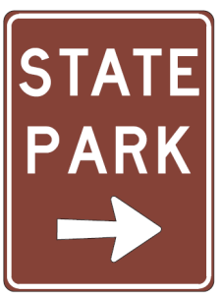
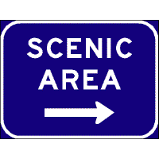
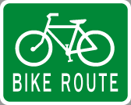

  Guide Signs
Notes:
Exit numbers will be the same number as the mile marker.
Mile markers show the number of miles from where the Interstate route entered a state.
The counting always begins at the state line in the south (for north-south routes) and in the west (for east-west routes).
Mile marker numbers always get larger as drivers travel east or north.

Slide 9
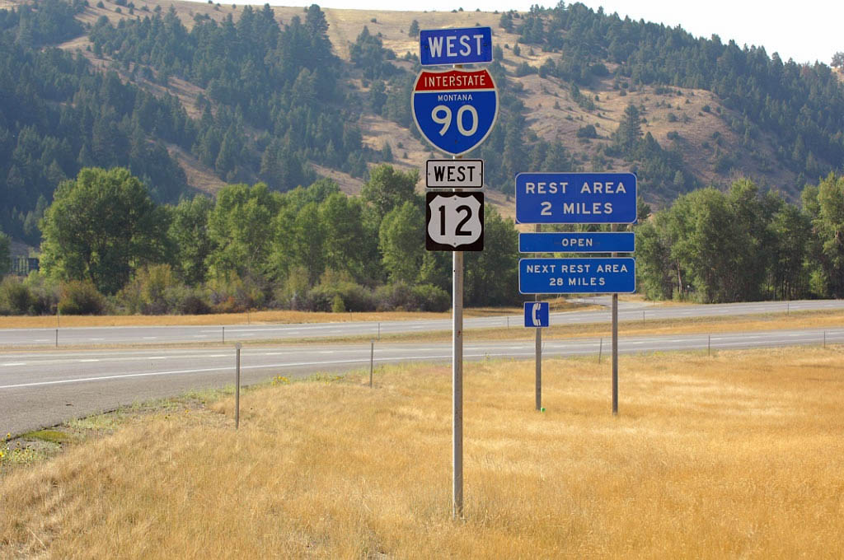
Notes:
Interstate Highway Numbers
Even numbers go east-west (I-90, I-94)
Odd numbers go north-south (I-15)
Numbers begin in the west and get larger as they move east
Alternate routes are usually three-digit

Slide 10
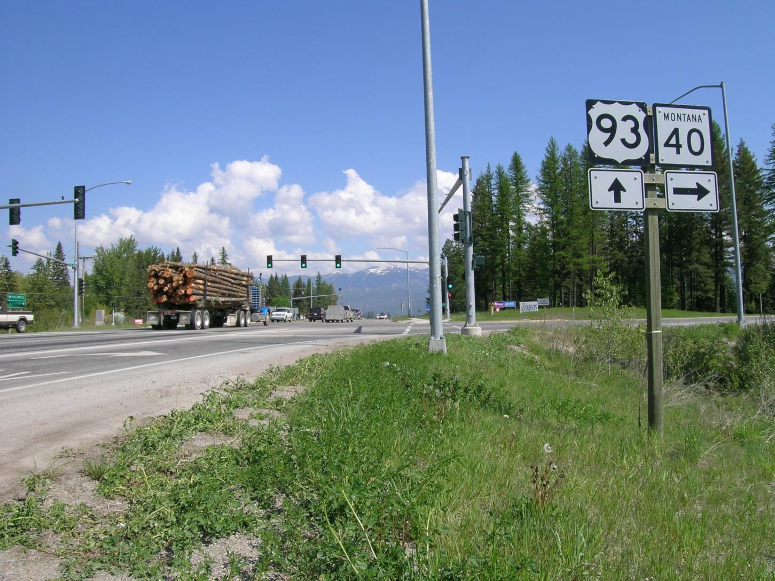
You want to drive north.
Do you go straight or turn here?
Notes:
Which way north? What do the signs tell you?

Slide 11
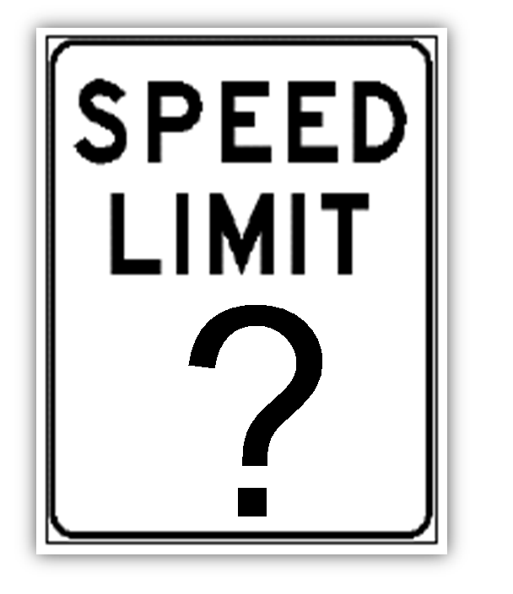
Unless otherwise posted…
Residential Streets
25 MPH
State Highways
50 - 70 MPH
Interstate (Freeway)
Varies
65 - 80 MPH
Notes:
In 2015, the Legislature approved an 80 mph speed limit on Interstate highways 15, 90 and 94 in areas other than cities with 55,000 population or more.
65 mph – all other roads and highways not meeting other definitions.
Montana Speed Limits History – From December 8, 1995 to May 28, 1999 Montana’s day time automobile speed limits were “reasonable and prudent,” under Basic Rule MCA 61-8-303(1).
In 1995, Congress repealed the 1974 National Maximum Speed Law fully returning speed limit setting authority to the states.

Slide 12



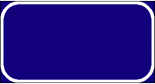




Regulatory, Warning or Guide?
Red
Green
Blue
Yellow
Black
White
Orange
Brown
Fluorescent

Slide 13



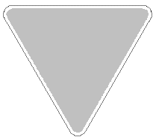



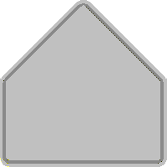

Shapes Have Meaning
Octagon
Rectangle
Triangle
Pennant
Diamond
Rectangle
Pentagon
Circle
Crossbuck
Notes:
What colors go with the sign shapes?
Use worksheet or flip charts on wall as graphic organizer.

Slide 14
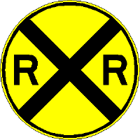
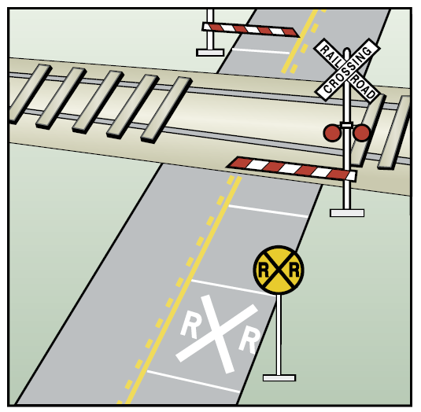
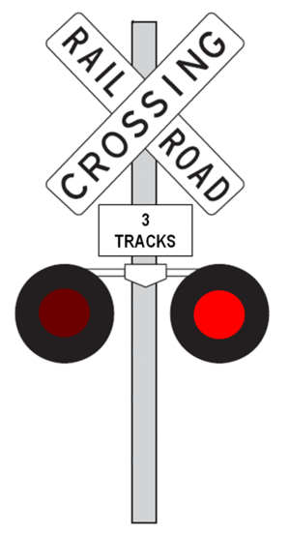

Railroad Crossing Warnings
RR sign or RR painted on the pavement are advanced warning signs.
Crossbucks are regulatory signs.
Drivers must yield!
Flashing red lights
Bells
Gates
If you hear or see a train:

Slide 15

Notes:
Identify the active and passive signals at this crossing
Ask student to take photos of local RR crossings
Freight trains don't travel at fixed times, and schedules for passenger trains change. Always expect a train at each highway-rail intersection.
All train tracks are private property. Never walk on tracks; it's illegal trespass and highly dangerous. By the time a locomotive engineer sees a trespasser or vehicle on the tracks it's too late. It takes the average freight train traveling at 55 mph more than a mile—the length of 18 football fields—to stop. Trains cannot stop quickly enough to avoid a collision.
The average locomotive weighs about 400,000 pounds or 200 tons; it can weigh up to 6,000 tons. This makes the weight ratio of a car to a train proportional to that of a soda can to a car. We all know what happens to a soda can hit by a car.
https://oli.org/education-resources/saftey-tips/safety-tips-and-facts

Slide 16










Line-of-Sight, Path-of-Travel Clues
Open, Closed or Unstable?
Closed
Open
Closed
Closed
Closed
Closed
Unstable
Closed
or Unstable
Closed
Unstable
Notes:
Detour= Closed Zone – Path is blocked cannot occupy that space
Limited Sight Distance = Closed zone – LOS is blocked
Yield = Closed Zone – Path temporarily blocked
Green Arrow Lane Open = Open Zone path is not blocked
Do Not Enter = Closed Zone – path is permanently blocked
Railroad Crossing = Closed or Unstable Zone – Danger, may be a train. Tracks on raised grade can be treated as closed / slow
Pavement Marking Arrow and Stop = Closed Zone – path temp blocked
Right Lane Ends = Closed Zone – path is permanently blocked
Pedestrian Crossing = Unstable Zone – Danger, may be pedestrians
Tractors ahead = Unstable Zone – Danger, may be slow moving tractor

Slide 17











Work Zones
Notes:
Barrel Bob Missouri Work Zone MDT

Slide 18







Work Zone Areas
Notes:
Orange signs signal work zone areas
Proceed with extreme caution
Drive at the posted speed
Watch out for workers
Stay in your lane
Report unsafe conditions

Slide 19

Photo courtesy of AAA Foundation

Slide 20



Work Zone Flaggers
Notes:
REMEMBER
Common Sense
Caution
Concentration

Slide 21

Going to the Sun Road
Glacier National Park

Slide 22





Work Zone Areas

Slide 23

Beartooth Highway 2005
Notes:
On May 20, 2005, mudslides from heavy rain and snow runoff damaged the Beartooth Highway at 13 sites along approximately 12 miles of roadway.
The Beartooth Highway which is part of US Highway 2012, opened in 1936. It begins at Red Lodge and winds 68 miles through the rugged and scenic Beartooth Mountains ending at the Northeast Entrance to Yellowstone National Park. At its highest point the road reaches 10,947 feet.

Slide 24









Intersections
Controlled by signs and signals
NOT Controlled by signs and signals, multi-lanes, or pavement
Single or two-lane road intersecting with multiple-lane road
T Intersections
Railroad grade crossings

Slide 25

Notes:
STOP sign – indicates What
STOP line – indicates Where

Slide 26

Notes:
First to Stop = First to Go.
Farthest Right Goes First.
Straight Traffic Goes First.
When in Doubt, Wait.
Even if you have the right-of-way, if for any reason you feel uncomfortable or that your safety is threatened, let the other traffic go ahead. Your safety always comes first.
Source: NHTSA

Slide 27



Red Traffic Signals
Solid Red Circle
  Stop is required
Flashing Red Circle
  Stop, proceed only when clear
Red Arrow
  Stop is required

Slide 28




Yellow Traffic Signals
Steady Yellow Circle
Warns a red will follow
Flashing Yellow Circle
Caution
Flashing Yellow Arrow
  Unprotected turn!
  Yield to oncoming traffic and pedestrians. Proceed only when clear.
Notes:
A flashing yellow left-turn arrow allows left turns and is used at an intersection with a dedicated left turn lane.

Slide 29







Green Traffic Signals
Green Circle
Proceed (look LFR first)
Unprotected turn:
Yield to oncoming traffic and pedestrians before turning left:
Green Arrows
Proceed without yielding
Protected turn:
(look LFR first)
Notes:
LFR: Left Front Right

Slide 30





Yield to Pedestrians
Notes:
MCA 61-8-504. Operators to exercise due care. Notwithstanding 61-8-501 through 61-8-503, an operator of a vehicle shall exercise due care to avoid colliding with a pedestrian or with a person propelling a human-powered vehicle or using an assistive mobility device upon a roadway, shall give warning by sounding the horn when necessary, and shall exercise proper precaution upon observing a child or an obviously confused, incapacitated, or intoxicated person upon a roadway.
NOTE: Vehicles on divided highway need not stop for school bus on a different roadway
MCA 61-8-351. Meeting or passing school bus
Upon overtaking from either direction a school bus that has stopped on the highway or street to receive or discharge school children, a driver of a motor vehicle:
(a) shall stop the motor vehicle not less than approximately 15 feet before reaching the school bus when there is in operation on the bus a visual flashing red signal as specified in 61-9-402; and
(b) may not proceed until the children have entered the school bus or have alighted and reached the side of the highway or street and until the school bus ceases operation of its visual flashing red signal.
(6) The driver of a motor vehicle upon a highway with separate roadways need not stop upon meeting or passing a school bus that is on a different roadway or when upon a controlled-access highway and the school bus is stopped in a loading zone that is a part of or adjacent to the highway and where pedestrians are not permitted to cross the roadway.

Slide 31




Pedestrian Countdown Signals

Slide 32

Notes:
Why did the Subaru miss the red light?
Where is the legal stop?
What is the danger here?

Slide 33

Notes:
Open and closed zones
Crosswalk
Don’t change lanes in the intersection
What is your following distance?

Slide 34


Slide 35


Notes:
Traffic Light Tree in London with 75 sets of lights at a roundabout
Created by French sculptor Pierre Vivant in 1998

Slide 36
Montana Driver Education and Training
Standards and Benchmarks
1. Laws and Highway System
  1.1. know the laws outlined in the Montana Driver's manual;
  1.2. understand the laws outlined in the Montana Driver's Manual; and
  1.3. consistently demonstrate knowledge and understanding by responsible adherence to highway transportation system traffic laws and control devices.
2. Responsibility
  2.1. recognize the importance of making safe and responsible decisions for owning and operating a motor vehicle;
  2.2 demonstrate the ability to make appropriate decisions while operating a motor vehicle;
  2.3. consistently display respect for other users of the highway transportation system; and
  2.4. develop positive habits and attitudes for responsible driving.
3. Visual Skills
  3.1. know proper visual skills for operating a motor vehicle;
  3.2. communicate and explain proper visual skills for operating a motor vehicle;
  3.3. demonstrate the use of proper visual skills for operating a motor vehicle; and
  3.4. develop habits and attitudes with regard to proper visual skills.
4. Vehicle Control
  4.1. demonstrate smooth, safe and efficient operation of a motor vehicle; and
  4.2. develop positive habits and attitudes relative to safe, efficient and smooth vehicle operation.
5. Communication
  5.1. consistently communicate driving intentions (i.e., use of lights, vehicle position, and personal signals);
  5.2. adjust driver behavior based on observation of the highway transportation system and other roadway users;
  5.3. adjust communication (i.e., use of lights, vehicle position, and personal signals) based on observation of the highway transportation system and other users; and
  5.4. develop positive habits and attitudes for effective communication.
6. Risk Management
  6.1. understand driver risk-management principles;
  6.2. demonstrate driver risk-management strategies; and
  6.3. develop positive habits and attitudes for effective driver risk-management.
7. Lifelong Learning
  7.1. identify and use a range of learning strategies required to acquire or retain knowledge, positive driving habits, and driving skills for lifelong learning;
  7.2. establish learning goals that are based on an understanding of one’s own current and future learning needs; and
  7.3. demonstrate knowledge and ability to make informed decisions required for positive driving habits, effective performance, and adaptation to change.
8. Driving Experience
  8.1. acquire at least the minimum number of BTW hours over at least the minimum number of days, as required by law, with a Montana-approved driver education teacher; and
  8.2. acquire additional behind-the-wheel driving experience with a parent or guardian’s assistance in a variety of driving situations (i.e., night, adverse weather, gravel road, etc.).
Notes:
Standards and Benchmarks: This is for your reference and not to be read to the class verbatim. Please review prior to the lesson so you are aware of what the student will be required to know at the end of the module.

